Slide 1
ORGANISATIONAL
BEHAVIOUR
CHAPTER-19
ORGANISATIONAL CULTURE, CREATIVITY, AND INNOVATION

Slide 2
LEARNING OBJECTIVES
Culture refers to norms, beliefs, and attitudes that knit organisational members together.
There are strong, dominant and weak cultures, and rational and business cultures.
Culture is created from several sources such as organisation structure, ethics, property rights, and the like.
Culture is sustained by selecting and socializing employees, actions of founders and leaders, managing cultural network and maintaining stable workforce.
Culture has both functional and dysfunctional effects.
Changing organisational culture is difficult but it needs to be changed, particularly when it is weak or unhealthy.
Creativity refers to discovery of new but situationally appropriate ideas.
There are ways and methods of enhancing creativity.
Innovation refers to giving life to creative ideas.

Slide 3
Features of Culture
        Individual Initiative: The degree of responsibility, freedom, and independence that individuals have.
        Risk Tolerance: The degree to which employees are encouraged to be aggressive, innovative, and risk-seeking.
        Direction: The degree to which the organization creates clear objectives and performance expectations.
        Integration: The degree to which units within the organization are encouraged to operate in a coordinated manner.
        Management Support: The degree to which mangers provide clear communication, assistance and support to their subordinates.
        Control: The number of rules and regulations, and the amount of direct supervision that is used to oversee and control employee behaviour.
        Identity: The degree to which members’ identify with the organization as a whole rather than with their particular work group or field of professional expertise.
        Reward System: The degree to which reward allocations are based on employee, performance criteria in contrast to seniority, favouritism, and so on.
        Conflict Tolerance: The degree to which employees are encouraged t air conflicts and criticisms openly.
        Communication Patterns: The degree to which organizational communications are restricted to the formal hierarchy of authority.

Slide 4
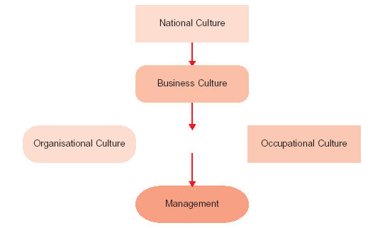
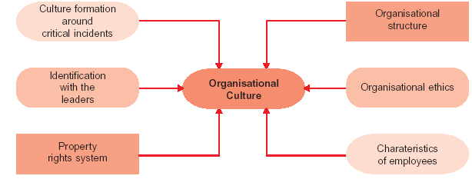
Levels of Culture
Where an Organisational Culture Comes From?

Slide 5
Chung Ju Yung and His Hyundai
Hyundai is a $ 45 bn-a-year business empire made up of more than 40 companies in fields ranging from ships to semiconductors, motor vehicle to computers, engineering to robots, petrochemicals to department stores. The Hyundai group is a disciplined militaristic organization. The man who made it this way is Chung Ju Yung.
Chung was born in 1915, one of the seven from an impoverished peasant farm family. Following World War II , Chung set up on auto repair business. He called it “Hyundai” which means modern in Korean. From this small beginning, the giant empire began. Throughout the company’s growth, Chung’s style shaped its culture. Family loyalty and authoritarianism reign.
At the height of his powers, chung was a fearsome figure. There are rumours that a stretcher used to be a fixture in Hyundai’s executive boardroom because Chung would sometimes punch out underlings who would not listen to him or do what he wanted.
Hyundai may represent an extreme in feudal obedience, but it evolved in to what Chung’s executives call the “Hyundai Spirit”. A manual given to new recruits states, “The hard work of the creator (Chung) and that of the pioneer have helped us open the way for expansion, sophistication and internationalization of the industrial society of our country”. In Hyundai lore and literature, Chung is quoted nearly as much as the Chinese, two decades ago, invoked Mao Zedong.
“Everything at Hyundai is run on a fairly military basis”, says a U.S. consultant. “They have an armory in the yard. The employees who are not educated all know what they have to do if war breaks out”.
If you want to understand Hyundai fierce, competitive style, its feudal obedience, or its disciplined, militaristic nature, you do not need to go any further than looking at its founder, Chung Ju Yung.

Slide 6
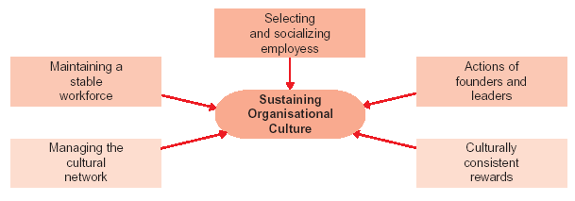
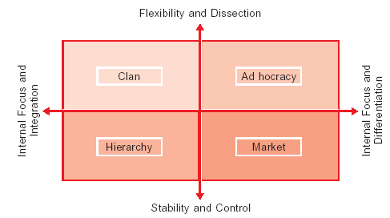
Strategies For Sustaining Culture
The Competing Values Approach To Culture

Slide 7
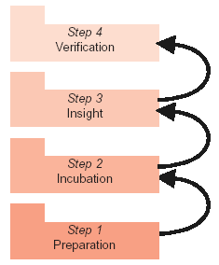
Steps in the Creative Process
Characteristics of Creative Individuals
A willingness to give up immediate gain to reach long-range goals
2. A great amount of energy
3. An irritation with the status quo
4. Perseverance
5. A pursuit of hobbies and specialized interests
6. A belief that fantasy and daydreaming are not a waste of time
Inventive thinking style
High intellectual abilities

Slide 8
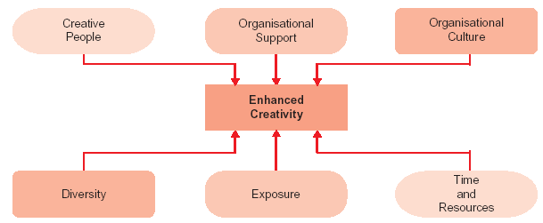
Conditions for Creativity

Slide 9
Sixty-One Ways to Block Creativity
A good idea but. The new people won’t understand.
Against company policy. The old timers won’t use it.
Ahead of the times. The timing is off.
All right in theory. The union won’t go for it.
Be practical. There are better ways.
Can you put it into practice? They won’t go for it.
Costs too much. Too academic.
Don’t start anything yet. Too hard to administer.
Have you considered. Too hard to implement.
I know it won’t work. Too late.
It can’t work. Too much paperwork.
Too many projects now. Too old fashioned.
It doesn’t fit human nature. Too soon.
It has been done before. We have been doing it this way for a
It needs more study. long time and it works.
It’s not budgeted. We haven’t the manpower.
It’s not good enough. We haven’t the time.
It’s not part of your job. We’re too big.

Slide 10
Sixty-One Ways to Block Creativity Contd….
Let me add to that. We’re too small.
Let’s discuss it. We’ve never done it that way.
Let’s form a committee. We’ve tried it before.
Let’s make a survey first. What bubble head thought that up?
Let’s not step on toes. What will the customers think?
Let’s put it off for a while. What will the union think?
Let’s sit on it for a while. What you’re really saying is.
Let’s think it over for a while. Who do you think you are?
Not ready for it yet. Who else has tried it?
Of course, it won’t work. Why hasn’t someone suggested
Our plan is different. it before if it’s a good idea?
Some other time. You are off base.
Surely you know better.
That’s not our problem.
The boss won’t go for it.

Slide 11
The most innovative companies of the twentieth century
An effective measure of an organization’s innovativeness is the number of U.S. patents it holds. Based on this, the following companies may be considered the most innovative companies of the twentieth century.
Rank Company Number of Patents
1 General Electric Co. 50,837
2 IBM Corp. 32,498
3 Westinghouse Electric Corp. 28,005
4 AT&T Corp. 24,578
5 General Motors 23,948
6 E.I.Du Pont de Nemours & Co. 23,559
7 Hitachi Ltd. 19,645
8 Eastman Kodak Co. 19,576
9 Canon Kubushiki Kaisha 18,876
10 United States Navy 17,805

Slide 12
Summary
        Organizational culture refers to the beliefs, norms, and attitudes that knit an organization together and are shared by its employees.
        There are national, business, organizational, and occupational cultures; mechanistic and organic cultures; authoritarian and participative cultures; dominant and sub-cultures; and strong, weak, and unhealthy cultures.
        Cultures come from several sources such as structures, ethics, employees, property rights systems, and leaders.
        Cultures can be sustained by selecting and socializing employees, actions by founders and leaders, instituting culturally consistent rewards and managing a cultural network.
        Culture has both functional and dysfunctional impact on organizations.
        Culture needs to be changed when it is weak or unhealthy. Before attempting to change, the existing culture needs to be understood. Behavioural approach, competing values approach, and deep assumptions approach help assess the existing culture.
        It is highly difficult to change culture but OB experts have suggested guidelines that can help change culture.
        Creativity refers to the way creative but appropriate ideas are brought out.
        Creativity does not occur in a jiffy. It goes through a four-stage sequential process.
        OB experts have suggested various techniques to enhance creativity.
        Creativity thrives in an environment supported by organizational culture, diversity, time and resources, and exposure of employees.
        Innovation is the process of converting ideas into useful goods and services. Like creativity, innovation also passes through a process.

Slide 13
Key Terms
Organizational culture
Groupthink
Clan
Competing values approach
Culture change
Creative individuals
Brainstorming
Innovation
Values
Artifacts
Subculture
Unhealthy culture
Cultural dimensions
Cultural network
Behavioural approach
Deep assumptions approach
Creativity
Grid analysis
Lateral thinking
Norms
Beliefs
Dominant culture
Weak culture
Socialization

